Slide 1
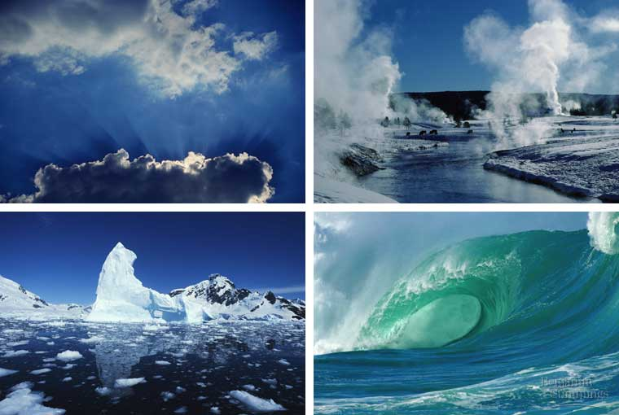
Properties of Water

Slide 2
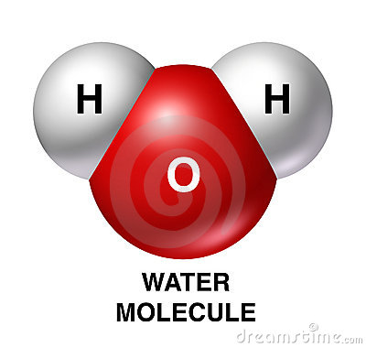
Water Molecule
1 oxygen atom, 2 hydrogen atoms
The 3 atoms are held together by polar covalent bonds
Electrons are not shared equally, they are closer to the oxygen
Molecule has a bent shape
7 Properties of water

Slide 3
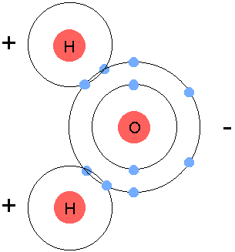
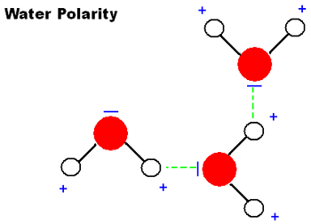
1. Polarity
Polar molecule – a molecule with positive and negative charged regions
This causes the – end of one water molecule to be attracted to the + end of a different water molecule
In water, electrons shared unequally
Oxygen is more electronegative, giving it a partial - charge
Hydrogen atoms get a partial + charge

Slide 4
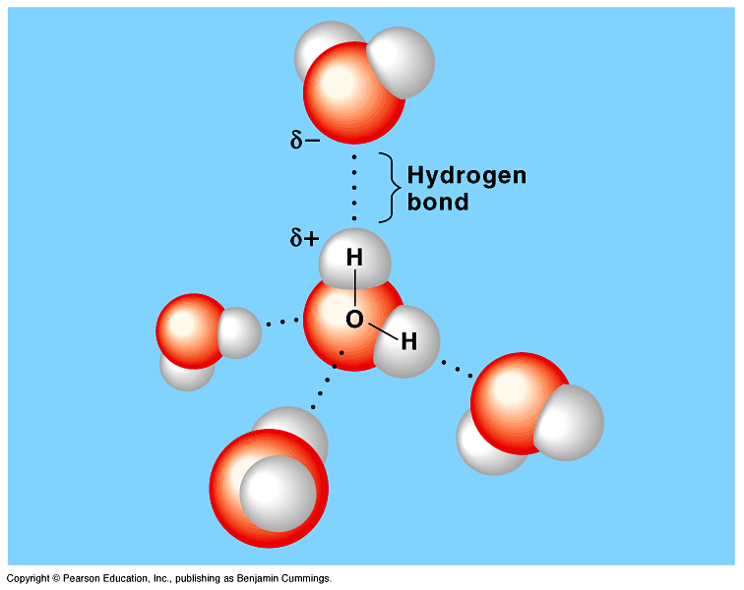
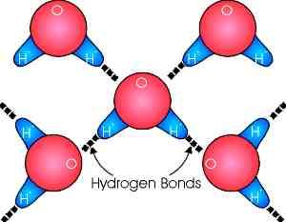
A hydrogen bond forms between the + oxygen and – hydrogen on the different molecules
Each water molecule can form hydrogen bonds with up to four neighbors.
Hydrogen bonds are very weak compared to covalent bonds, they break and reform easily
But!-They are the basis for the other properties of water
Fig. 3.1
Copyright © 2002 Pearson Education, Inc., publishing as Benjamin Cummings

Slide 5
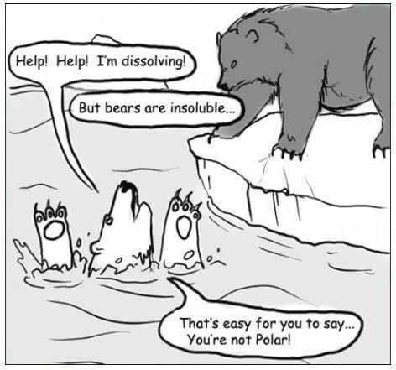

Slide 6
2. Capillary Action
Capillary Action – the ability water has to flow upward against the force of gravity, due to cohesion and adhesion
Cohesion (cohesive) – sticking together of two like molecules
2 water molecules are cohesive due to the hydrogen bonds
Adhesion (adhesive) – sticking together of two unlike molecules
Ex: A water molecule being attracted to a sugar molecule (Like making Kool-aid)

Slide 7
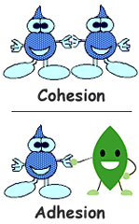

Slide 8
DEMO!
Take a dry 5 c coin.
Slowly add drops of water to the penny.
How many drops can you add?

Slide 9
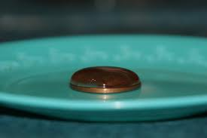
COHESION!!
Mr Dhue managed 46 drops! How did you do?

Slide 10

How does water get to the top of plants?
Cohesion & Adhesion
Cohesion among water molecules causes them to pull one another upward against gravity
Adhesion contributes too, as water adheres to the wall of the vessels, so it can travel upward

Slide 11
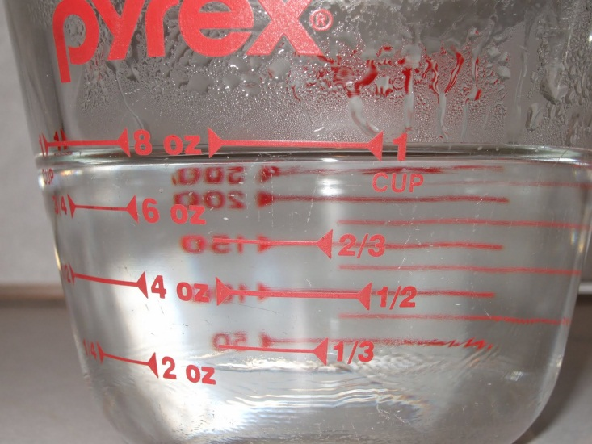
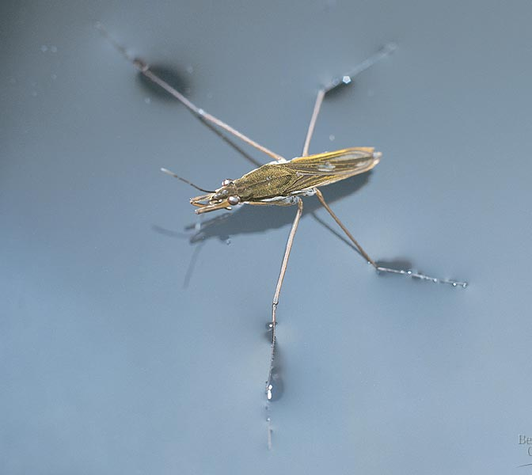
3. Surface Tension
Surface tension- a measure of the force necessary to stretch or break the surface of a liquid
Hydrogen bonds between water molecules at surface of water resist breaking creating an “invisible film”
This allows some insects to walk/run on water

Slide 12
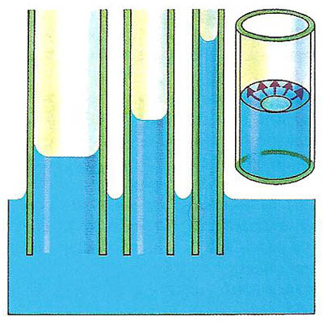
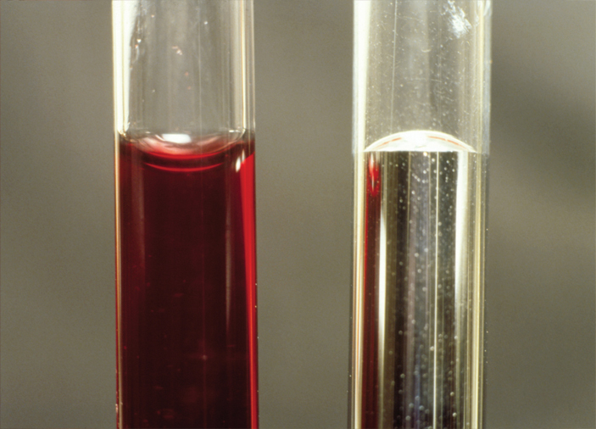
Fig. The water's surface (left, dyed red) is curved down because water has greater adhesion than cohesion. The surface of the mercury (right) is curved up because mercury has greater cohesion than adhesion.

Slide 13
DEMO!
Take a dry paper clip and carefully try to lay it on the surface of the water

Slide 14
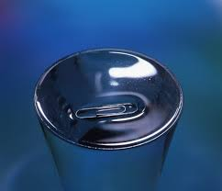
SURFACE TENSION

Slide 15
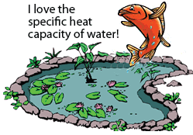
4. Heat Capacity
High specific heat – hydrogen bonds give water abnormally high specific heat. This means water resists changes in temperature.
Water also helps maintain homeostasis inside cells by keeping temperatures stable.
For instance, our fish in the pond is indeed happy because the heat capacity of the water in his pond above means the temperature of the water will stay relatively the same from day to night. He doesn't have to worry about either turning on his air conditioner or putting on his woolen flipper gloves.

Slide 16
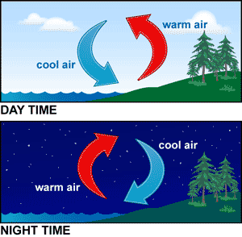
Heat Capacity
Because of this water stabilizes air temperatures
Cool water absorbs heat from warm air
Ex: Coastal cities have mild weather

Slide 17
Practice
1. Which of the following describes a hydrogen bond?
a. the bond between two hydrogen atoms within a molecule of water
b. the bond between hydrogen in one water molecule and another hydrogen in a different water molecule
c. the bond between hydrogen and oxygen within a molecule of water
d. the bond between hydrogen in one water molecule and oxygen in a different water molecule
Which of the following is an example of heat capacity/specific heat?
ice floats in water
sugar disappears when added to water.
it takes several weeks of warm temperatures to raise lake water several degrees.

Slide 18
5. Heat of Vaporization
Heat of Vaporization- The cooling of a surface occurs when the liquid evaporates
Ex: water boils → as the steam leaves the water it takes the heat with it, and the water cools
Ex: Your body sweats so the water will absorb your heat then evaporate to cool you.

Slide 19
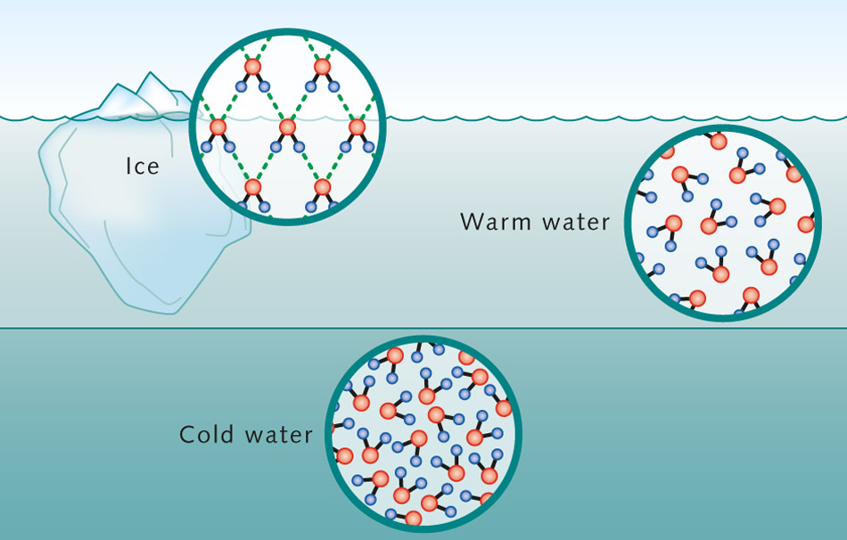
6. Density
Density- a measure of how compact the atoms or molecules are within a substance or how much mass there is in a given space (volume)
Water is more dense as a liquid than as a solid

Slide 20
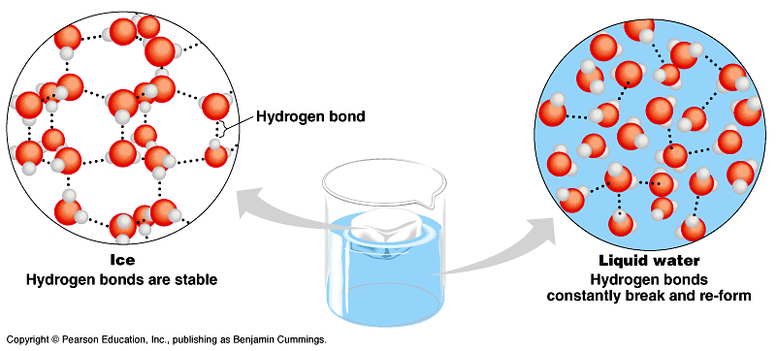
When water freezes and becomes ice, the polarity causes hydrogen bonds to form but there is air in between
Causes expansion
Ice floats in water.
If this didn’t happen all the icebergs would sink- water levels would rise.
Ice floats on top and insulates water below- fish can live.

Slide 21
7. Universal Solvent
Solvent- a liquid that dissolves a particle (solute)
Solute- particle or liquid that gets dissolved in the solvent
Ex: Salt water → Water- Solvent, Salt- Solute
Water is a solvent that dissolves most solutes.

Slide 22
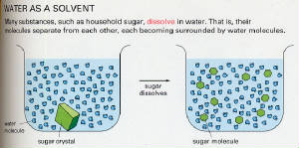
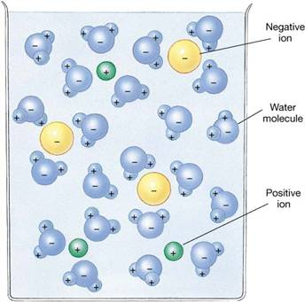
If the solute molecules are polar, like water, the positive ends of water are attracted to the negative ends of the solute.
This is also why the solute is even throughout all the water

Slide 23
Practice – Write down the number and answer
1. The hydrogen and oxygen atoms are held together by ___ bonds.
2. The electrons are not shared equally creating a __ molecule.
3. The polarity of water allows it to __most substances. Because of this it is referred to as the __ __.
4. Water molecules stick to other water molecules. This property is called ___.
5. Hydrogen bonds form between adjacent water molecules because the __charged hydrogen end of one water molecule attracts the __ charged oxygen end of another water molecule.
6. Water molecules stick to other materials due to its polar nature. This property is called __.
7. ___ ___ creates the skin-like surface formed due to the polar nature of water.

Slide 24
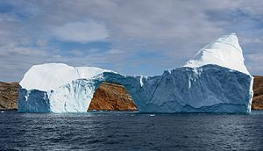
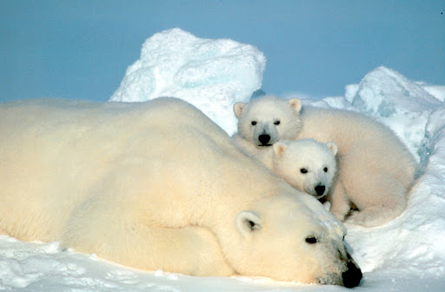
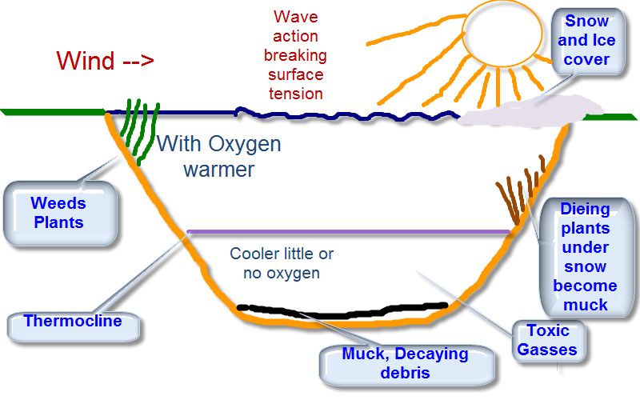
Properties of Water and their Connection to Life on Earth
Density
Specific heat
Density

Slide 25
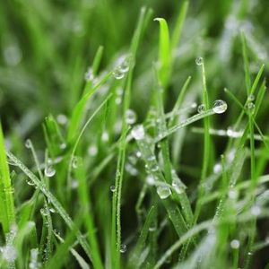
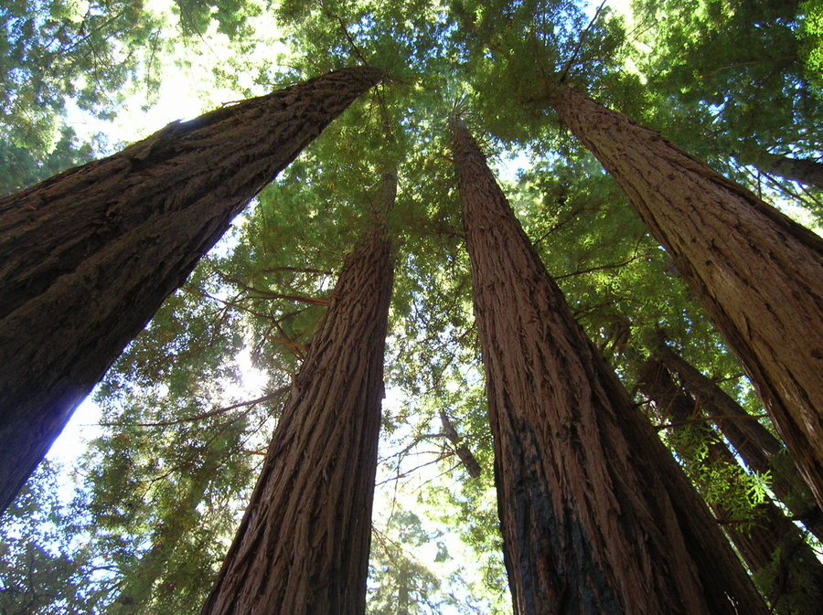


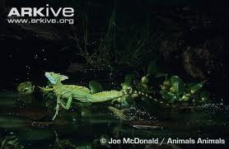
Properties of Water and their Connection to Life on Earth
Cohesion
Surface Tension
Surface Tension
Cohesion
Adhesion
Capillary Action
Cohesion

Slide 26
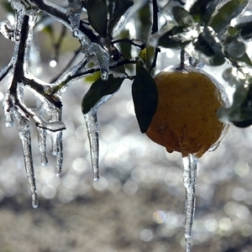

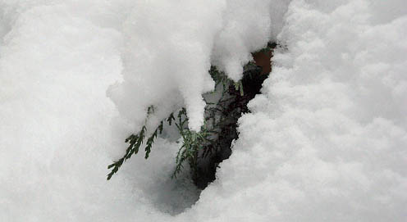
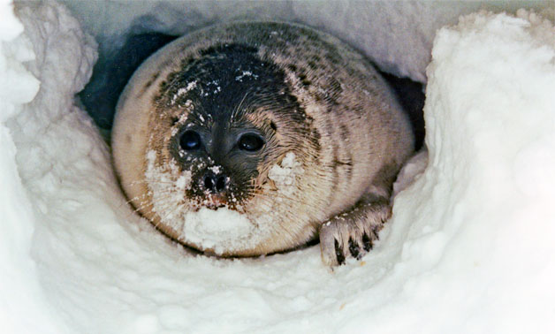
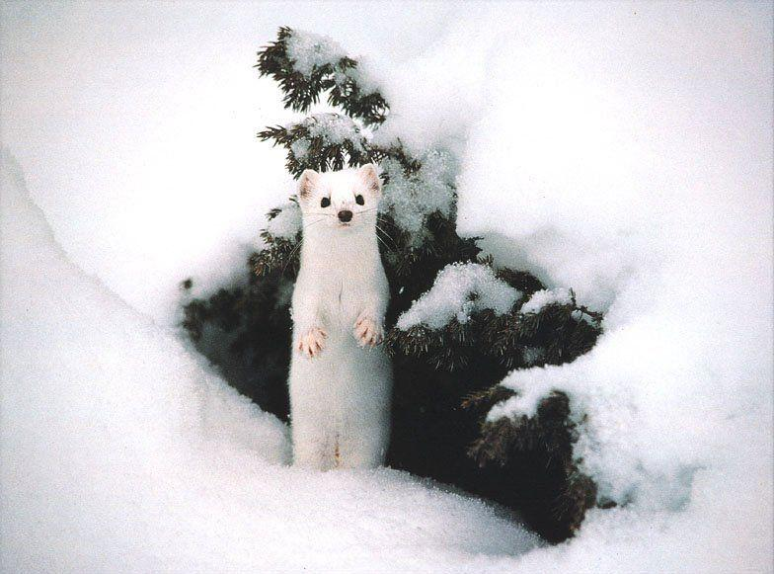
Properties of Water and their Connection to Life on Earth
Specific heat
Insulation

Slide 27
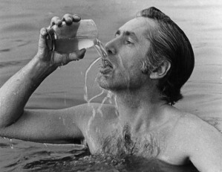
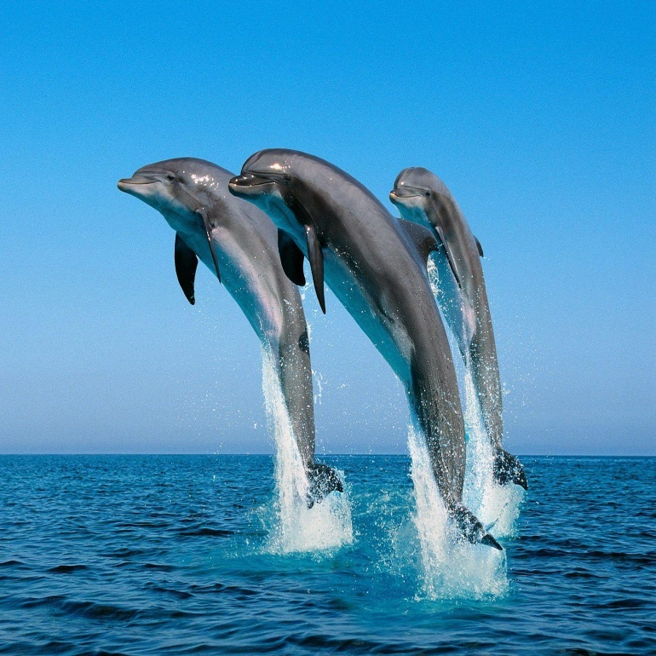
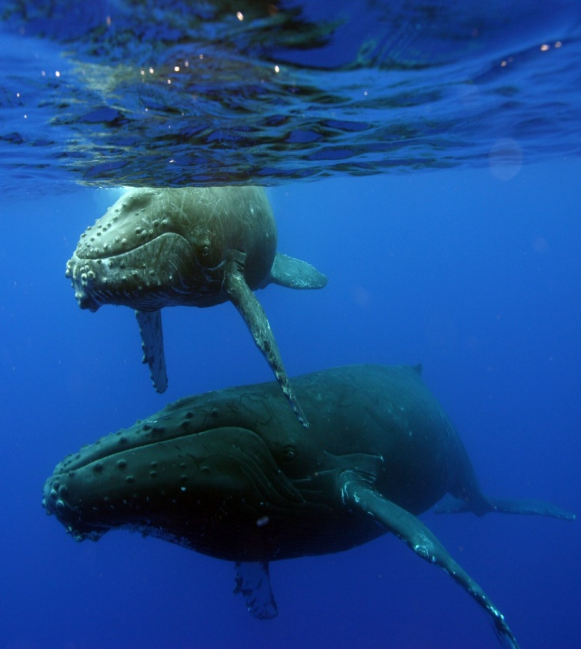

Properties of Water and their Connection to Life on Earth
Solubility
Specific Heat
Density

Slide 28
Let’s Review!
Water molecules move farther apart when water freezes, causing it to expand. Which of the following is a consequence of this property?
Only a limited amount of solute can be dissolved in a sample of water.
Objects with a higher density than water can be observed floating on water.
The water in lakes, ponds and puddles freezes from top down.
Water is considered to be a universal solvent.
2. Water makes an upward curved meniscus in a graduated cylinder. What property of water accounts for the attraction of the water to the glass?
Adhesion
Cohesion
Ionic Bonds
Nonpolar Covalent Bonds

Slide 29
Let’s Review!
3. Water is a polar molecule that attracts other polar molecules. Which of the following is a consequence of this property?
Water is considered to be a universal solvent.
Water can only dissolve a limited amount of solute.
When water freezes, the molecules move farther apart.
The water in lakes, ponds and puddles freezes from top down.
4. Water has a high surface tension. What property of water allows an insect to walk on water?
Adhesion
Cohesion
Ionic Bonds
Nonpolar Covalent Bonds

